Slide 1

Java Abstract Data Types Lists, Stacks, Queues and more
CS 1181 – Computer Science II
Dr. Michael Raymer
Lecture materials adapted from:
ZyBooks ISBN: 979-8-203-16123-9 Dr. Cay Horstmann, Univ. of Michigan Dr. Roman Lysecky, Univ. of Arizona
Dr. Adrian Lizarraga, Univ. of Arizona
Dr. Travis Doom
Dr. Michelle Cheatham
Unless otherwise noted images are used under the creative commons license or used under license from Adobe Stock.

Slide 2


There’s more to coding than making code work.
To be successful, you also need to learn to make code efficient. Part of this is making code run fast.
To do that, we must understand how our code actually runs on the hardware.

Slide 3
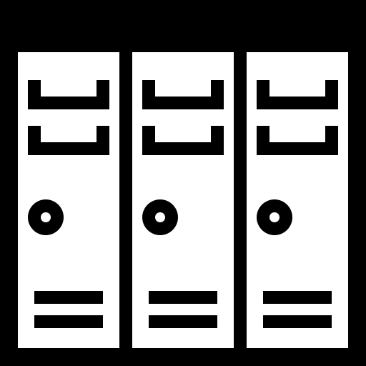
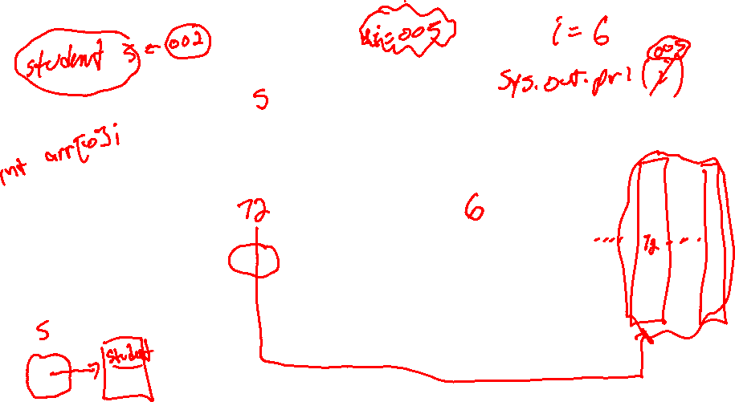
Understanding RAM
001
002
003
004
005
006

Slide 4
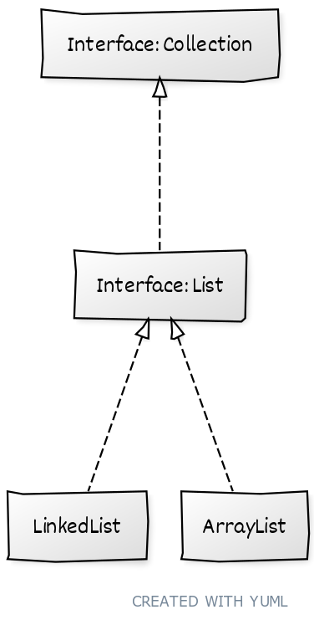
More than one way to make a list
add(int index, E element)
get(int index)
isEmpty()
remove(int index)

Slide 5



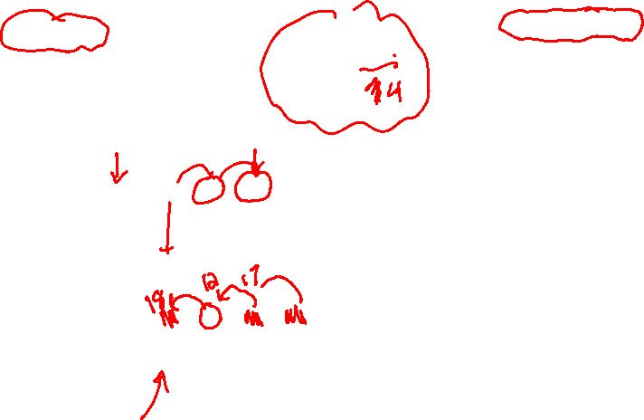
ArrayLists
Where can I find myList.get(3)?
myList
start: 4
size: 5
000
001
002
003
004
005
006
007
008
009
010
011
012
013
014
015
016
017
21
32
18
12
17
Notes:
Inserting, resizing, etc.
Memory fragmentation

Slide 6
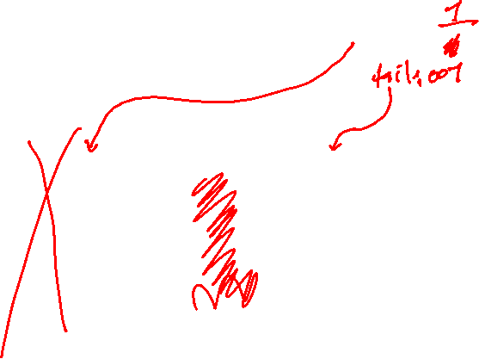
LinkedLists
Where can I find myList.get(3)?
myList
head: 4
000
001
002
003
004
005
006
007
008
009
010
011
012
013
014
015
016
017
32
10
21
01
17
null
18
15
12
07
Notes:
Inserting, resizing, etc.
Memory fragmentation

Slide 7
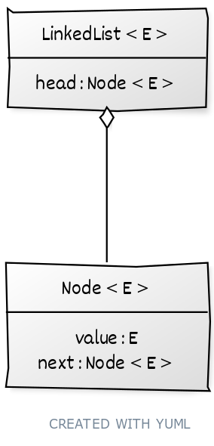
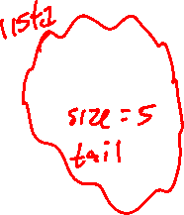
Linked lists
value
next
head
21
32
18
12
17
null
node
public class LinkedList<E>

Slide 8
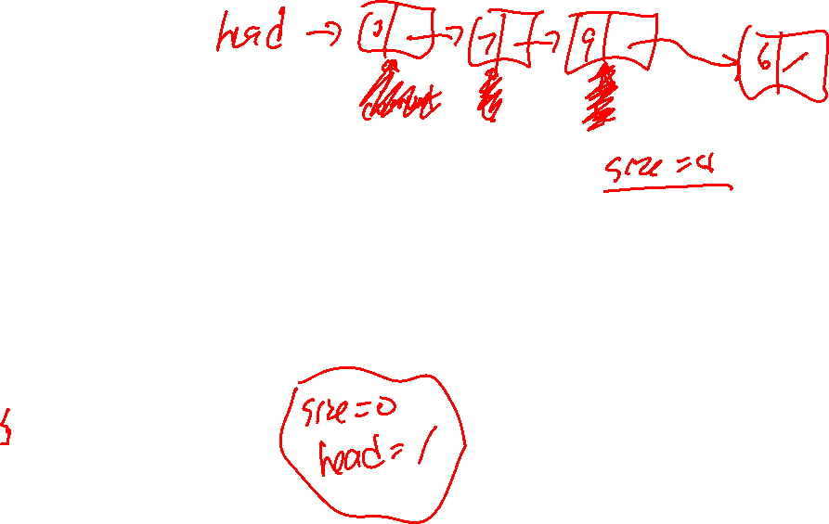
public void addLast(E item){
Node<E> current = head;
// Find the last list element
while (current.next != null){
current = current.next;
}
current.next = new Node<E>(item);
size++;
}

Slide 9








public void addFirst(E item){
Node<E> newNode = new Node<E>(item);
newNode.next = head;
head = newNode;
size++;
}

Slide 10
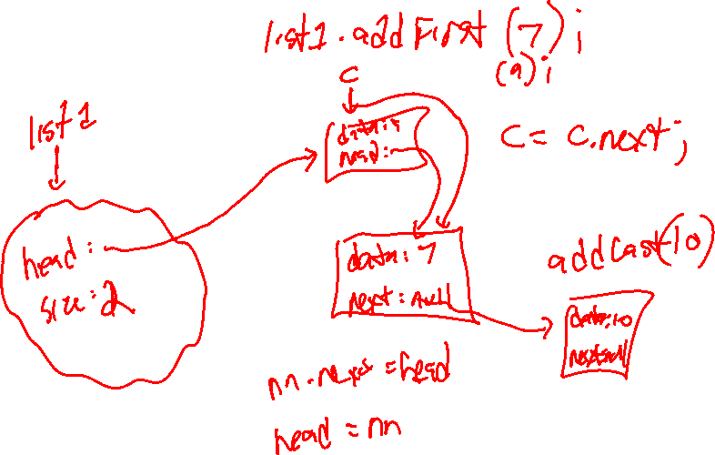

Slide 11
Let’s make it Iterable
for (Integer i : ilist){
System.out.println(i);
}
public boolean hasNext()
public E next(){

Slide 12
What about this?
for (Integer i : ilist){
for (Integer j : ilist){
System.out.println(i + ", " + j);
}
}
i
j
head
21
32
18
12
17
null

Slide 13
Iterator objects
for (Integer i : ilist){
for (Integer j : ilist){
System.out.println(i + ", " + j);
}
}
next
next
head
21
32
18
12
17
null

Slide 14


Iterator, iterator() and Iterable
Interface | Method(s)
Iterable<T> | Iterator<T> iterator()
Iterator<E> | boolean hasNext() E next()
LinkedList<Integer>
Iterator<Integer>
head
Iterator<Integer>
next
itorator()
next
21
32
18
12
17
null

Slide 15
Speeding it up: DoubleLInkedList
value
21
32
18
12
17
head
next
null
prev
null
tail

Slide 16
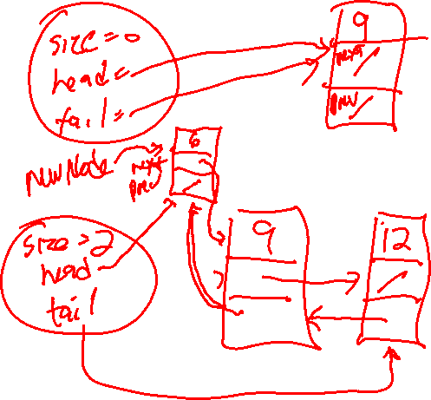

Slide 17
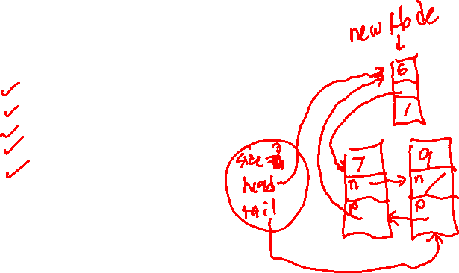
public void addFirst(E item){
if (head == null){
head = tail = new Node<E>(item);
size = 1;
}
else {
Node<E> newNode = new Node<E>(item);
newNode.next = head;
head.prev = newNode;
head = newNode;
size++;
}

Slide 18
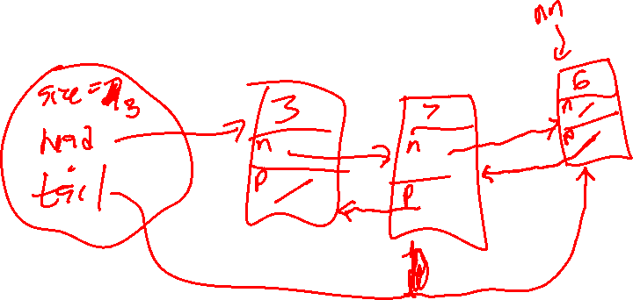

Slide 19
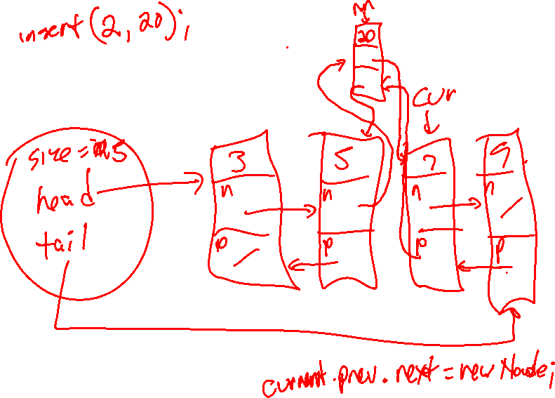
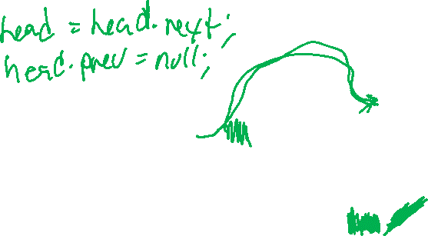

Slide 20
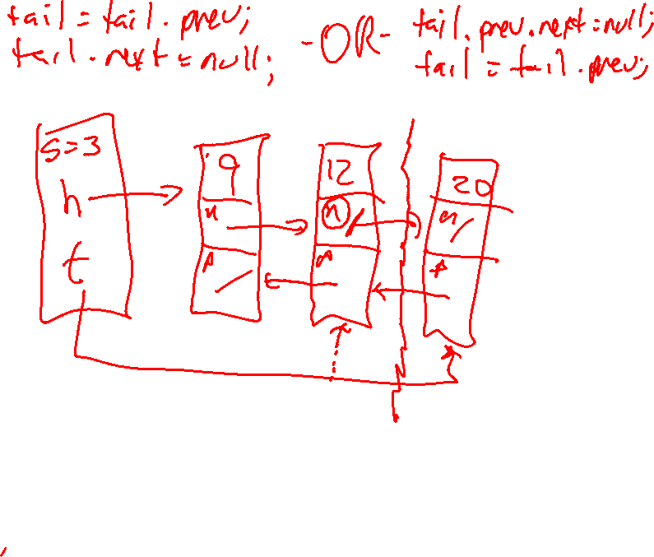

Slide 21
Which one is “better”?
add(int index, E element)
get(int index)
isEmpty()
remove(int index)
Notes:
Add and Get: Beginning, middle, end.

Slide 22
Try it out
List<Integer> l = new ArrayList<>();
or
List<Integer> l = new LinkedList<>();
l.add(12);
l.add(15);
l.add(0, 22);
l.addFirst(0, 22); // Yes? No? Maybe?
…
Notes:
Using the interface reference variable allows me to change types at any time!

Slide 23

Check Your Understanding
Write a method to remove the third item from a singly-linked list.
If we add a Tail pointer to a singly-linked list, which operations are faster? Which are not?
Which is faster: a LinkedList or an ArrayList?

Slide 24
ADTs and Data Structures
Data Structure
Abstract Data Type
How is the data arranged in memory?
What do you want to do with the data?

Slide 25



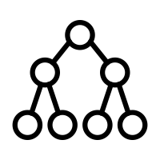
ADT or Data Structure?
LottoBag
Transcript
Playlist
Binary Tree

Slide 26
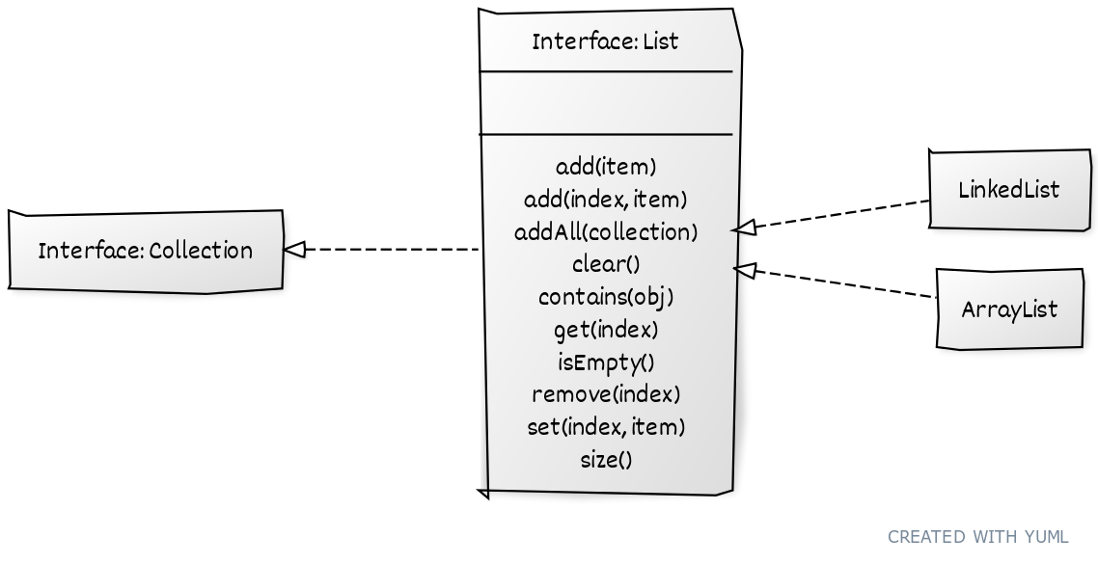
ADTs and Interfaces

Slide 27

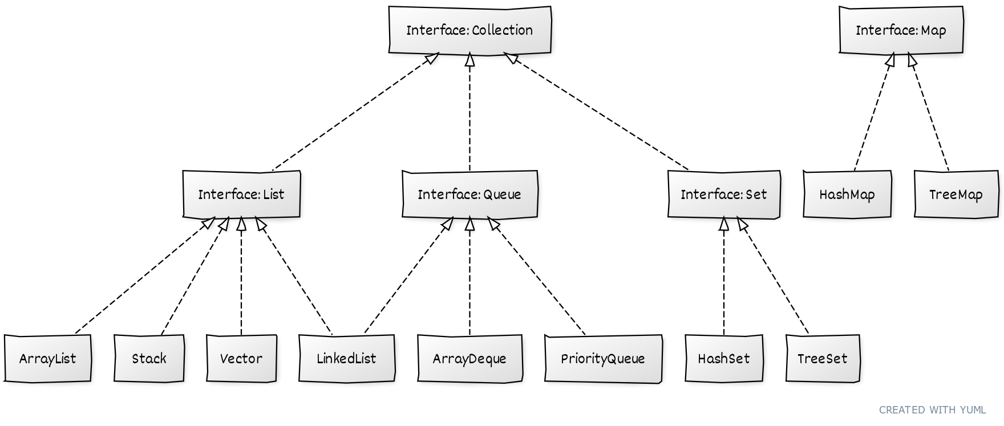
Interesting ADTs in Java

Slide 28

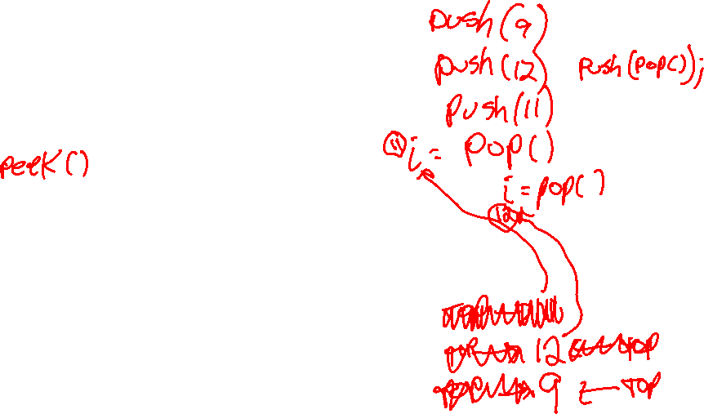
Stacks
Last-in / First-out (LIFO)
push()
pop()
isEmpty()
https://yongdanielliang.github.io/animation/web/Stack.html

Slide 29
Stack practice
push(9)
push(21)
push(13)
pop()
push(14)
pop()
pop()
push(7)

Slide 30
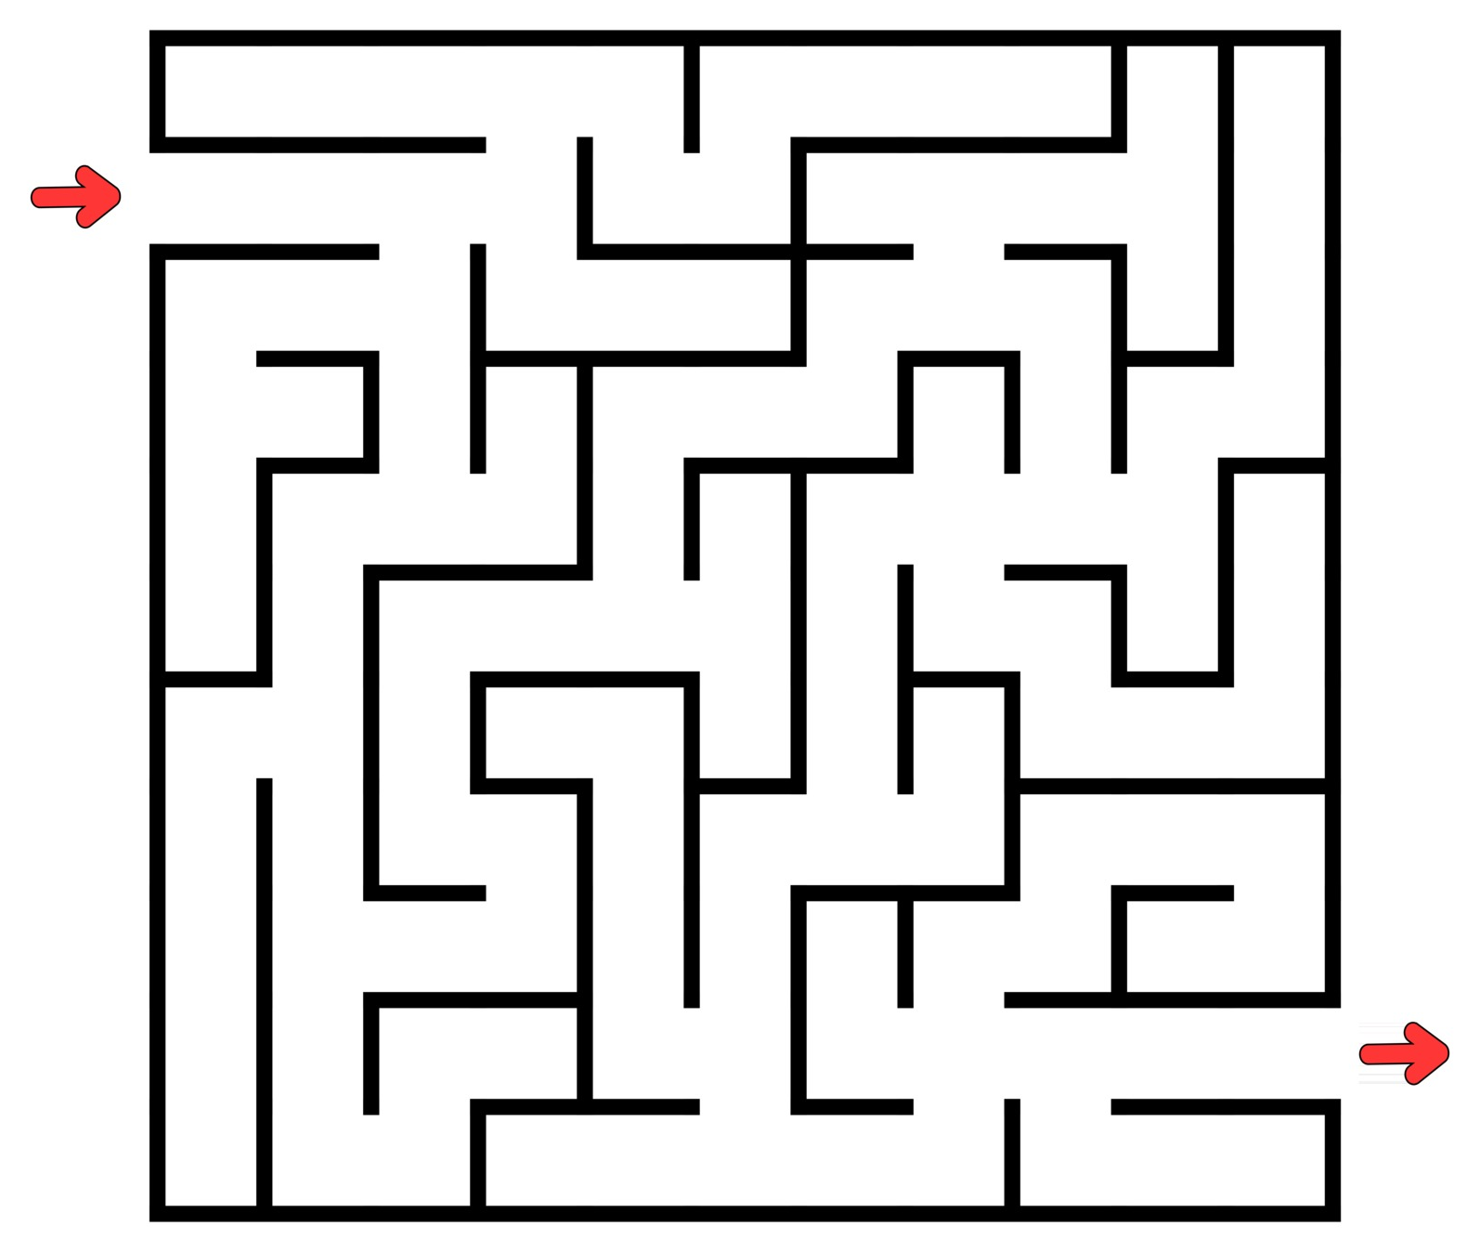

What is it good for?
Ctrl + Z
0
1
2
3
4
5
6
7
8
9
10
0
1
Left Right Up Down
2
3
4
5
6
7
8
9
10

Slide 31
Try it out
import java.util.Stack;
public class StackMain{
public static void main(String[] args) {
Stack<Integer> s = new Stack<>();
…
}
}

Slide 32

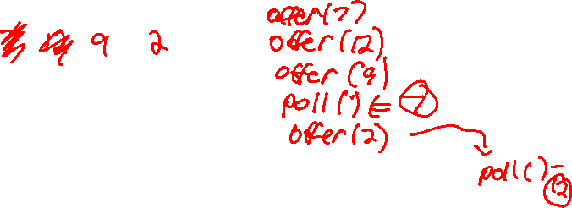
Queue
First-in / First-out (FIFO)
Img source: https://nystudio107.com/blog/robust-queue-job-handling-in-craft-cms
offer() poll() isEmpty()

Slide 33
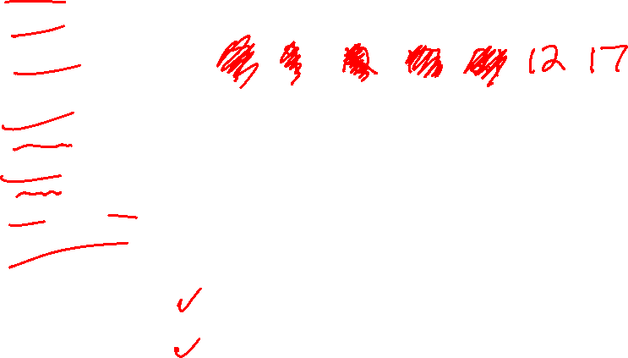
Queue practice
offer(7)
offer(9)
offer(12)
poll()
poll()
offer(17)
offer(21)
offer(poll())
offer(poll())
poll()
Front
Back
https://yongdanielliang.github.io/animation/web/Queue.html

Slide 34
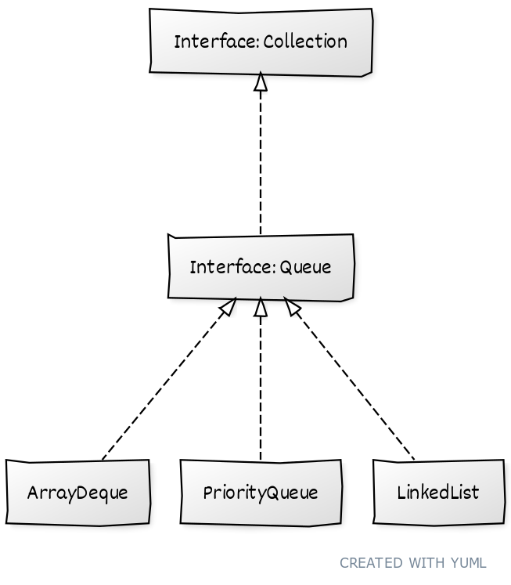
Queues in Java
 | Throws exception | Returns null
Insert | add(e) | offer(e)
Remove | remove() | poll()
Examine | element() | peek()

Slide 35
Linked Queues
Front
Back
value
21
32
18
12
17
head
next
null
prev
null
tail

Slide 36
Array-based Queues
Front
0
1
2
3
4
5
6
7
8
9
10
11
5
6
7
8
Back
An ordinary array won’t work because we’ll run out of space (even when the queue is not full!).

Slide 37
Circular Queues
0
1
2
3
4
5
6
7
8
9
10
11
Front
-1 = Empty
Back

Slide 38
Which one is “better”?
offer(E element)
poll()
isEmpty()
Notes:
Pointer operations are 2x slower. Resizing when full is slow for array.

Slide 39
Try it out
Queue<Integer> q = new ArrayDeque<>();
or
Queue<Integer> q = new LinkedList<>();
q.offer(12);
q.offer(22);
…

Slide 40
What does this do (in general)?
…
Queue queue = new Queue();
…
Stack stack = new Stack();
while ( !queue.isEmpty() ) {
stack.push ( queue.poll() );
} // end-while
while (!stack.isEmpty()) {
queue.offer( stack.pop() );
} // end-while
…

Slide 41
How about this?
When n = 10? In general?
int n = 10;
…
Stack stack = new Stack();
while (n>0) {
stack.push ( n % 2);
n = n/2;
} // end-while
while (!stack.isEmpty()) {
System.out.print(stack.pop());
} // end-while
System.out.println();
…

Slide 42
Priority Queues
Poll() always provides the “highest priority” value.
Highest priority == the one that comes first in when sorting
Numbers: Lowest first
Strings: Alphabetical/Lexical order
Others: Depends on compareTo()
Note: Not sorted internally!
Notes:
Requires items to implement Comparable!

Slide 43
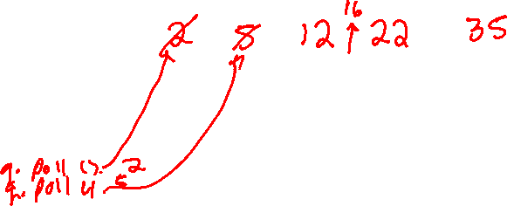
Priority Queue example
PriorityQueue<Integer> q = new PriorityQueue<>();
q.offer(12);
q.offer(22);
q.offer(5);
q.offer(16);
q.offer(35);
q.offer(2);
System.out.println(q);
while (!q.isEmpty()){
System.out.println(q.poll());

Slide 44



Where might this be useful?

Slide 45
Using a comparator
PriorityQueue<Integer> q = new PriorityQueue<>(comparator);
public interface Comparator<T> {
int compare(T first, T second);
}
Since this interface requires just one method, we can use a lambda expression!
PriorityQueue<Integer> q = new PriorityQueue<>((a, b) -> {code});

Slide 46


Maps (a.k.a. Dictionaries)
A map works like a lookup table
Key ⇒ Value
Keys must be unique
Key (UID) | Value (Last Name)
00001234 | Raymer
00249138 | Jain
11024913 | Smith
2024978 | Raymer
Values can have duplicates

Slide 47
Try it out
// Make a Map from Equipment# to Name (Integer to String)
// and add some Key/Value pairs:
Map<Integer, String> checkOuts = new HashMap<>();
checkOuts.put(123, "Raymer");
checkOuts.put(345, "Wischgoll");
checkOuts.put(778, "Raymer");
checkOuts.put(664, "Doom");
checkOuts.put(123, "Doom");

Slide 48
Sorting the keys
.keySet() gets us all the keys in a Map, but as a Set
We’ll talk about Sets shortly, but the main thing to know here is that they are unordered.
If we want to sort them, we need to convert the set to something with an ordering (like a List!) first:
Set<Integer> allEqNums = checkOuts.keySet();
ArrayList<Integer> orderedNums = new ArrayList<>(allEqNums);
Collections.sort(orderedNums);

Slide 49

Another example
Read a text file and count the number of times each word appears
Key (Word : String) | Value (Count : int)
The | 22
Black | 7
Cow | 3
Jumped | 2

Slide 50
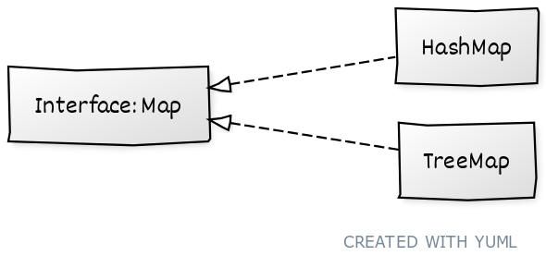
Which one?
Searches using a Hash Table
Searches using a natural ordering
Notes:
When in doubt, use HashMap

Slide 51
Sets
Sets have
No order
No duplicates
We are primarily interested in knowing whether an element is in a set or not.

Slide 52
Example
A palette might be implemented as a set of colors to choose from
boldPalette = {red, blue, green, purple}
softPalate = {mint, olive, tan, rose, purple}

Slide 53
Set Operations
Intersection: set1 ⋂ set2 = {F, Q, R}
M
A
F
Q
Z
B
R
D

Slide 54
Set Operations
Union: set1 ⋃ set2 = {A, B, D, F, Q, R, M, Z}
M
A
F
Q
Z
B
R
D

Slide 55
Set Operations
Subtraction: set1 - set2 = {A, B, D}
M
A
F
Q
Z
B
R
D

Slide 56
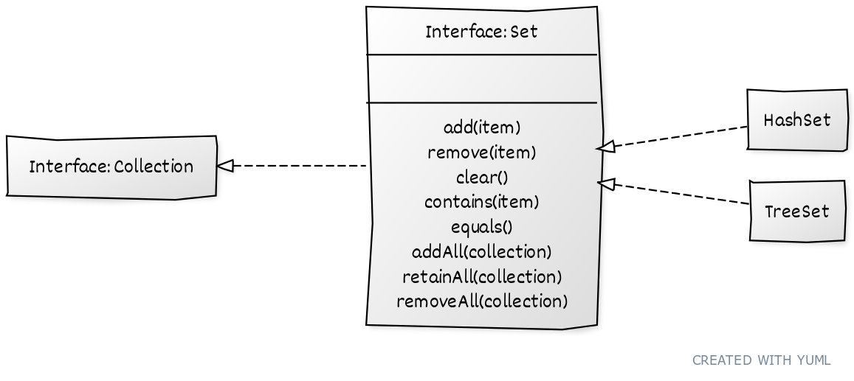
Sets in Java
Notes:
How do we do union? Intersection? Subtraction?

Slide 57
Try it out
Set<Integer> s1 = new HashSet<>();
What happens when you add a duplicate?
How about when you remove a non-existent element?

Slide 58

Today’s Quiz Password
extends

